Slide 1
CPU Scheduler in C
Randy Yu, Robin Pan, Eric Collins

Slide 2
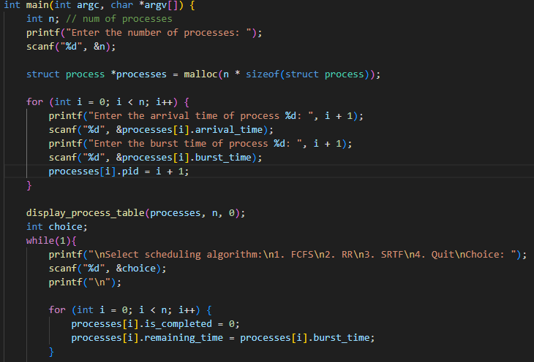
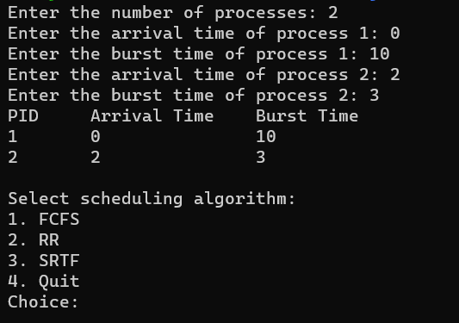
Code Breakdown
Prompt users to enter number of processes
Main:
Users will specify arrival and burst times for each process
Display processes to user, then ask for them to select the queue type they would like to simulate
User may want to use multiple queue types, so we reset completion flag and remaining time

Slide 3
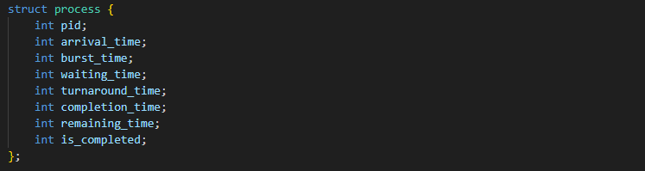
Code Breakdown
We make every process queued by the user into a process structure
Allows for easy organization and modification of each process
Contains info including arrival and burst time, as well as completion status. 1 indicates finished, 0 indicates not finished
Other variables will be calculated as process finishes and updated accordingly

Slide 4
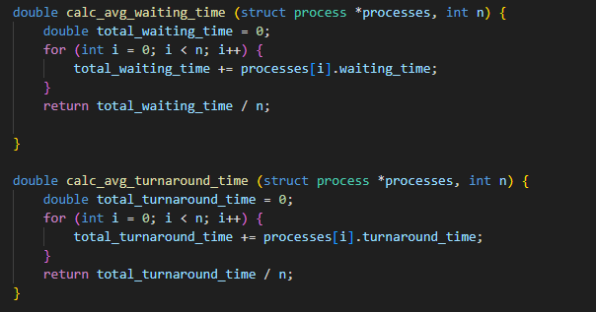
Code Breakdown
Helper functions that calculate the average waiting and turnaround times. Add up all times and divide by number of processes

Slide 5
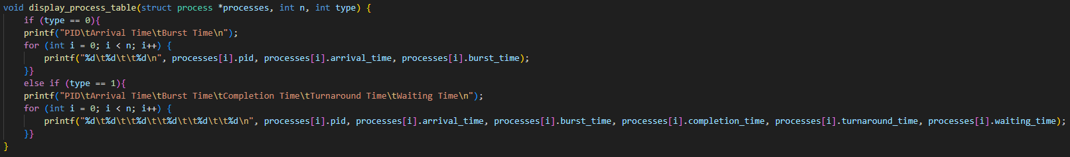
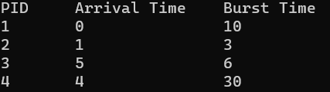
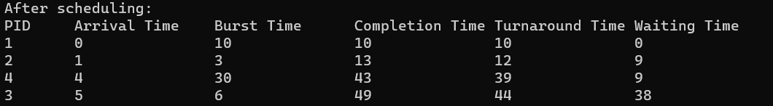
Code Breakdown
Very simple helper function that prints all of the processes along with their arrival and burst times
We can set a flag to print waiting, turnaround, and completion times as well
Output

Slide 6
First In First Out

Slide 7
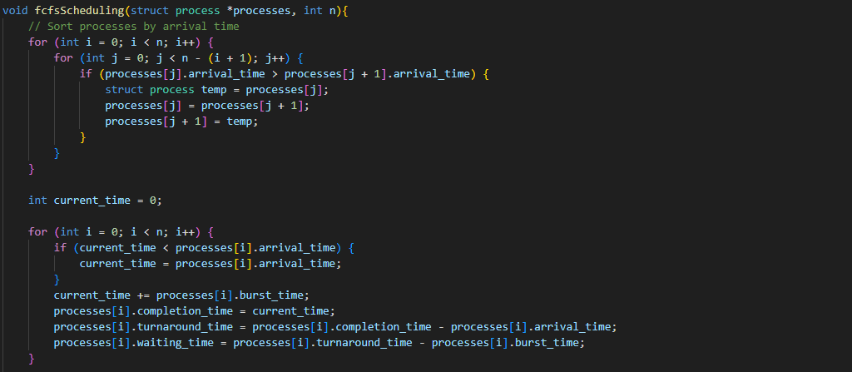
First Come First Served (Or First In First Out)
Sort processes based on arrival time so we don’t have to continuously compare processes against one another
Set current time to arrival time if arrival time is larger
When process finishes, update current, completion, turnaround, and waiting times

Slide 8
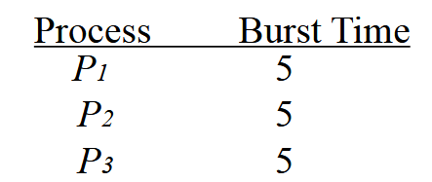
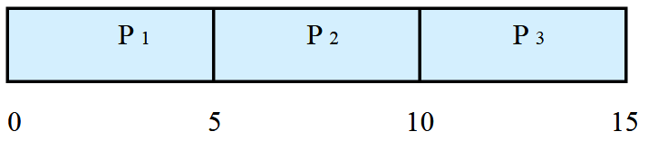
Example
Average Waiting Time = 5s
Average Turnaround Time = 10s

Slide 9
Example
Process Arrival Time Burst Time
P₁ 5 1
P₂ 8 15
P₃ 10 7
P₄ 7 5
P₅ 2 9
P₆ 0 2
P₇ 15 10
P₈ 15 3
Process Completion Time
P₆ 2
P₅ 11
P₁ 12
P₄ 17
P₂ 32
P₃ 39
P₇ 49
P₈ 52
(0+0+6+5+9+22+24+34) = 100
(2+9+7+10+24+29+34+37) = 152s
Average Waiting Time = 100/8 = 12.5s
Average Turnaround Time = 152/8 = 19s

Slide 10
Shortest Time Remaining First

Slide 11
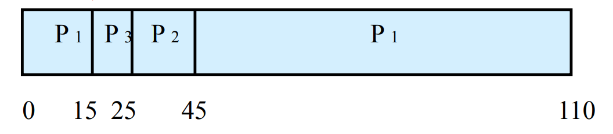
Shortest Remaining Time -to-Completion First
The CPU schedules the processes based their arrival time and remaining time to completion.
Whenever a new process arrives, the CPU will evaluate the remaining time to completion of all the current processes.
The CPU schedules the process with the shortest remaining time.
EX:
Process | Arrival Time | Burst Time
P1 | 0 | 80
P2 | 15 | 20
P3 | 15 | 10

Slide 12
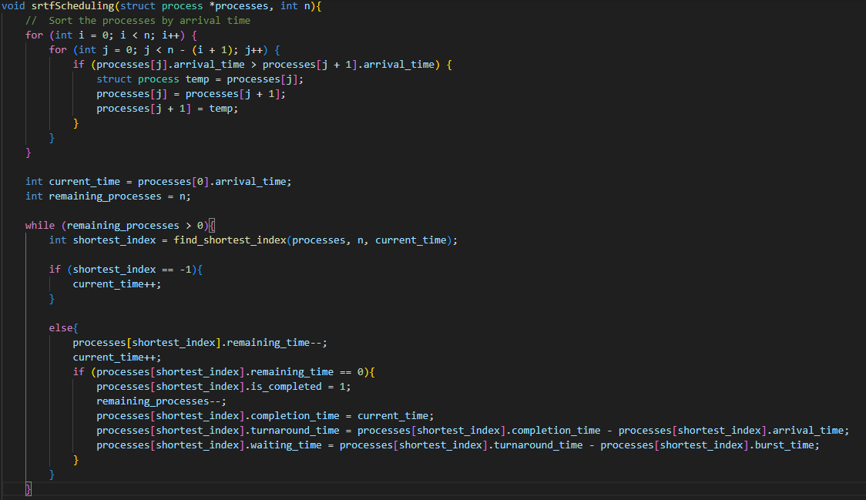
Code Breakdown
Sorting the processes based on their arrival times
Initialize a curtime_time variable to represent the time of simulation and a remaining_processes variable to keep track of the unfinished jobs.
Find the process with the shortest remaining time
If no process was scheduled, increment current_time by 1. This can happen if there are jobs arriving after the current_time
If we scheduled a job. We just decrement the remaining time of that job by 1 and increment the current_time by 1. If the remaining time becomes 0. We update all other variables of that process.

Slide 13
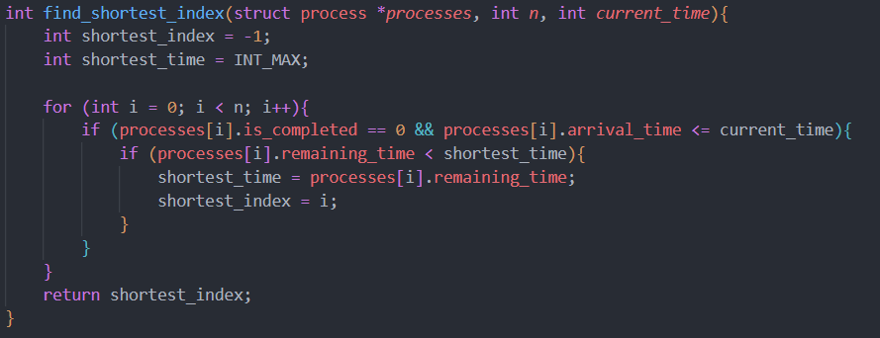
Code Breakdown
Loop through all the processes, check if the process is not finished and it has arrived. Store the shortest time and the corresponding process index. Return the index of that process in the array.

Slide 14
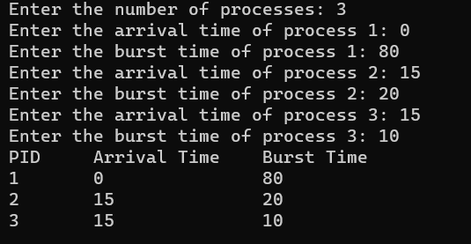
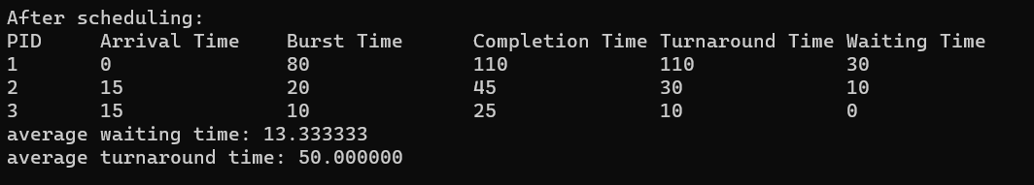
Code Output

Slide 15
Example
Process | Arrival Time | Burst Time
1 | 0 | 40
2 | 5 | 10
3 | 10 | 15
4 | 20 | 5
5 | 30 | 25
P1 | P2 | P2 | P3 | P4 | P3 | P5 | P1
0
5
10
15
20
25
35
60
95
P₁ arrives
P₂ arrives
P₃ arrives
P₄ arrives
P₅ arrives at t = 30s

Slide 16
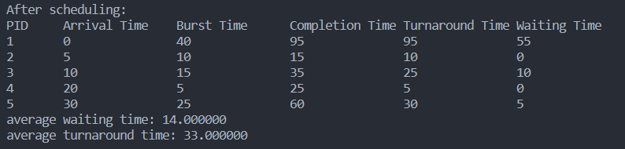

Slide 17
Round Robin

Slide 18
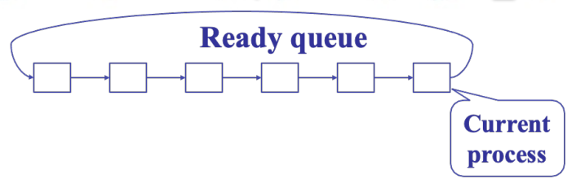
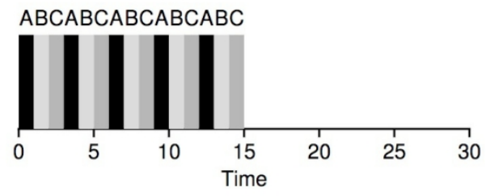
Round Robin
Round robin allocates a fixed time slice to each process in a circular queue
If the time slice is exceeded, the current process is replaced by the next in line

Slide 19
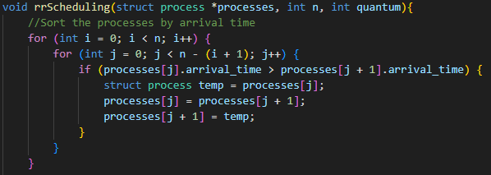
Code Breakdown
Processes are sorted by arrival time

Slide 20
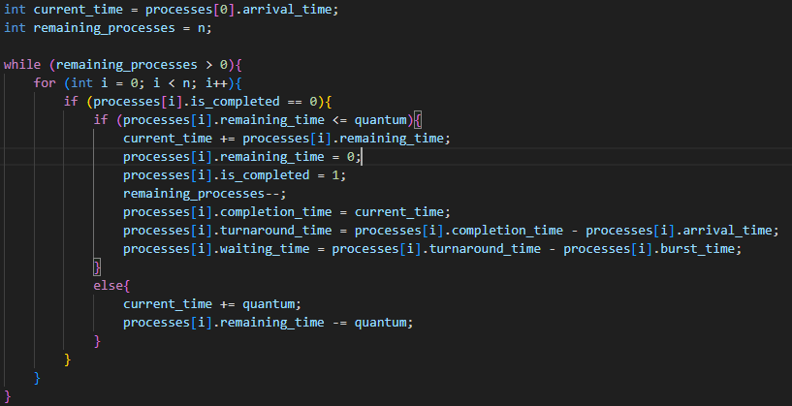
Code Breakdown
Initialize current time to arrival time of the first process
Counter for number of remaining processes
While any processes are incomplete, iterate over all unfinished processes
If process can be completed within time slice, update current time, mark as completed, decrement remaining process count, calculate time stats
Otherwise, update remaining and current time using the time slice

Slide 21
Example
Process | Arrival time (s) | Burst time (s)
P1 | 0 | 6
P2 | 1 | 4
P3 | 2 | 1
P4 | 3 | 3
P5 | 4 | 5
P6 | 4 | 2
Time Slice
6s
P1 | P2 | P3 | P4 | P5 | P6
0 6 10 11 14 19 21

Slide 22
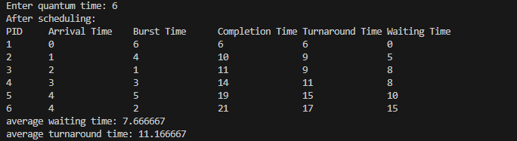
Code Output

